Slide 1
UNDERSTANDING HARMONY IN NATURE
Name: Vaka Prasanna
Roll No: 20BQ1A05O6
Section: 4-CSE-D
Subject: UNIVERSAL HUMAN VALUES (Mid-2)
College: vasireddy Venkatadri institute of technology

Slide 2
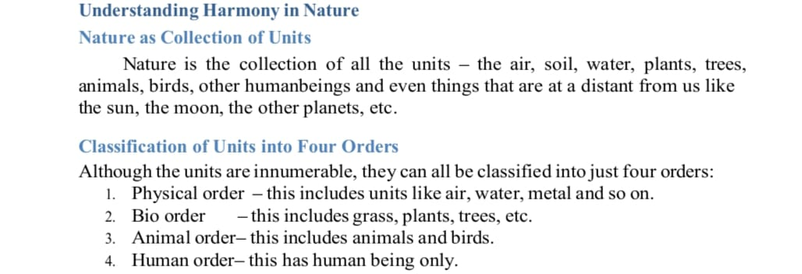
Understanding harmony in nature

Slide 3
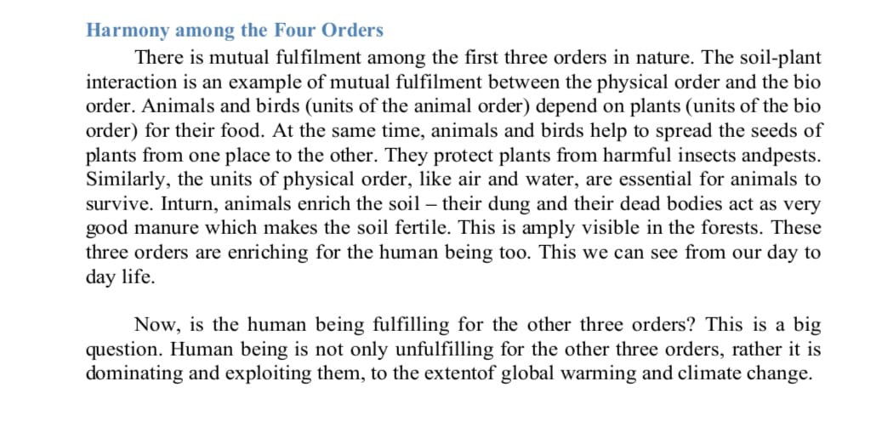
Understanding harmony in nature

Slide 4
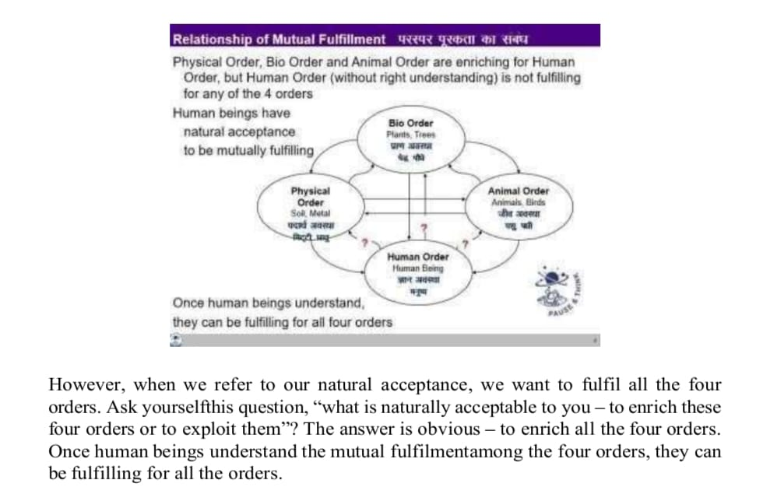
Understanding harmony in nature

Slide 5
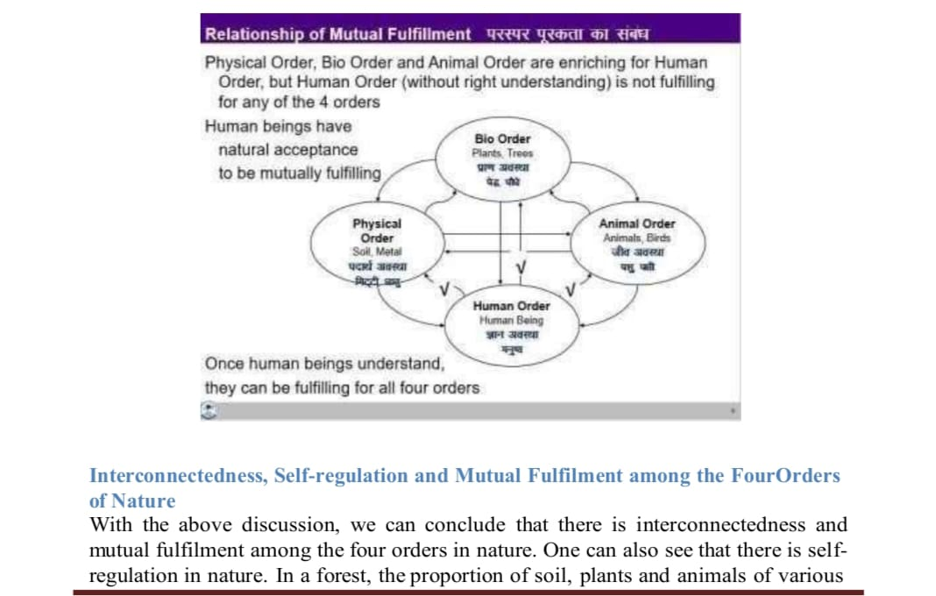
Understanding harmony in nature

Slide 6
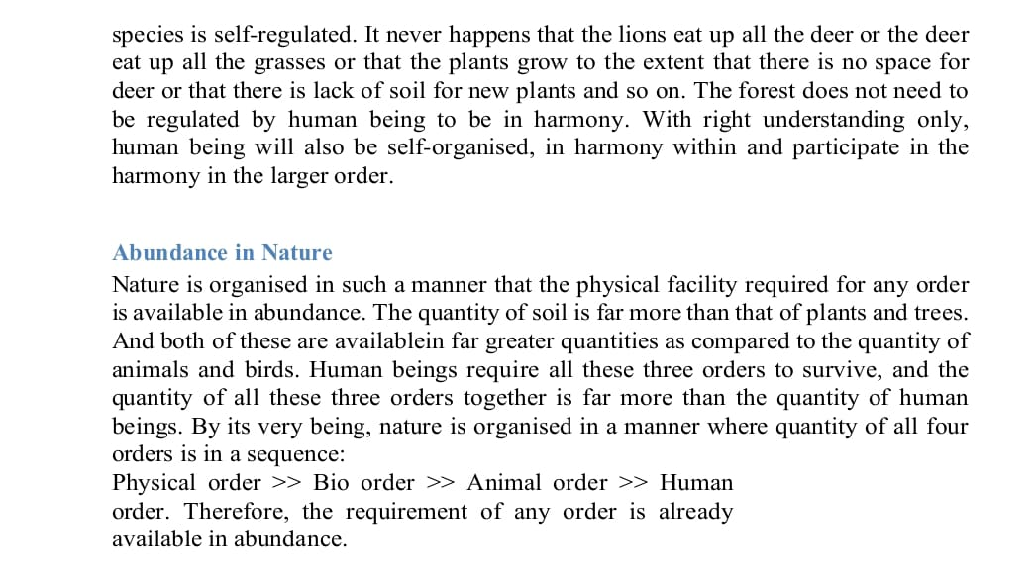
Understanding harmony in nature

Slide 7
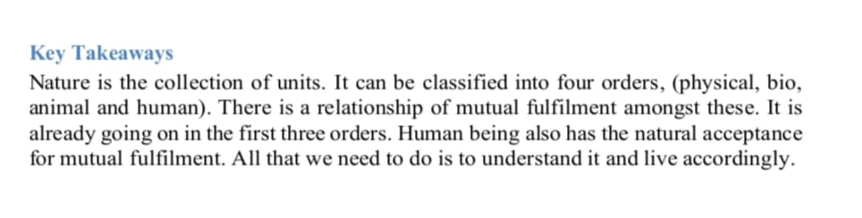
Understanding harmony in nature

Slide 8


